Slide 1
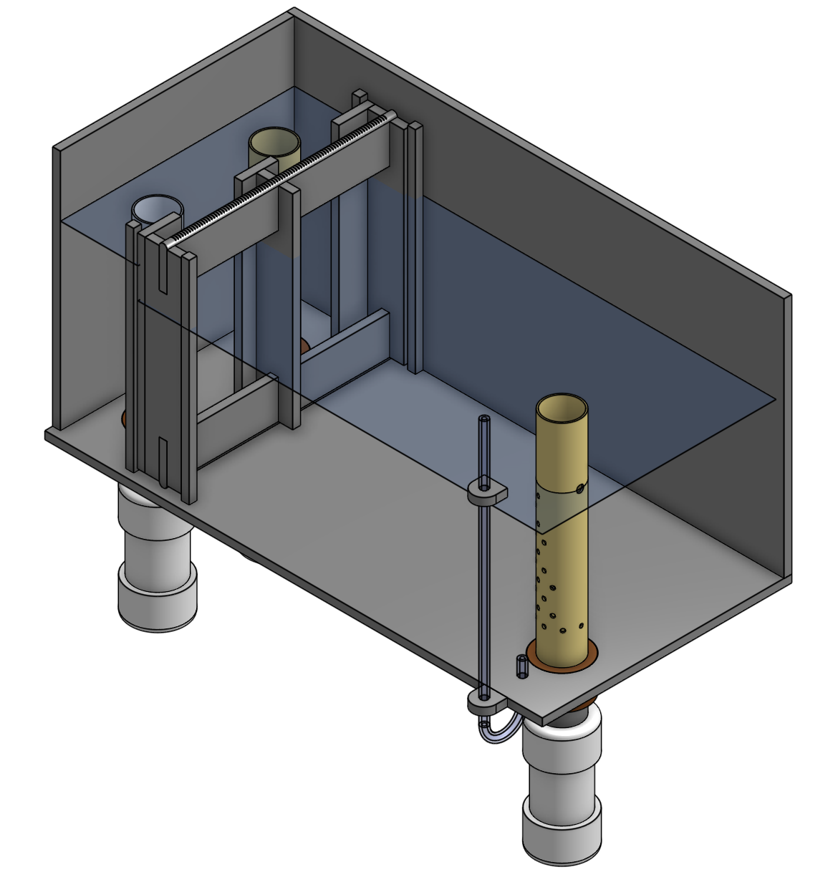
DRAIN PIPE STUB
TRASH RACK
LFOM
INFLUENT PIPE
FLOW MEASUREMENT TUBE & SCALE
PIPE TO FLOCCULATOR
FLOW PATH
WATER LEVEL

Slide 2
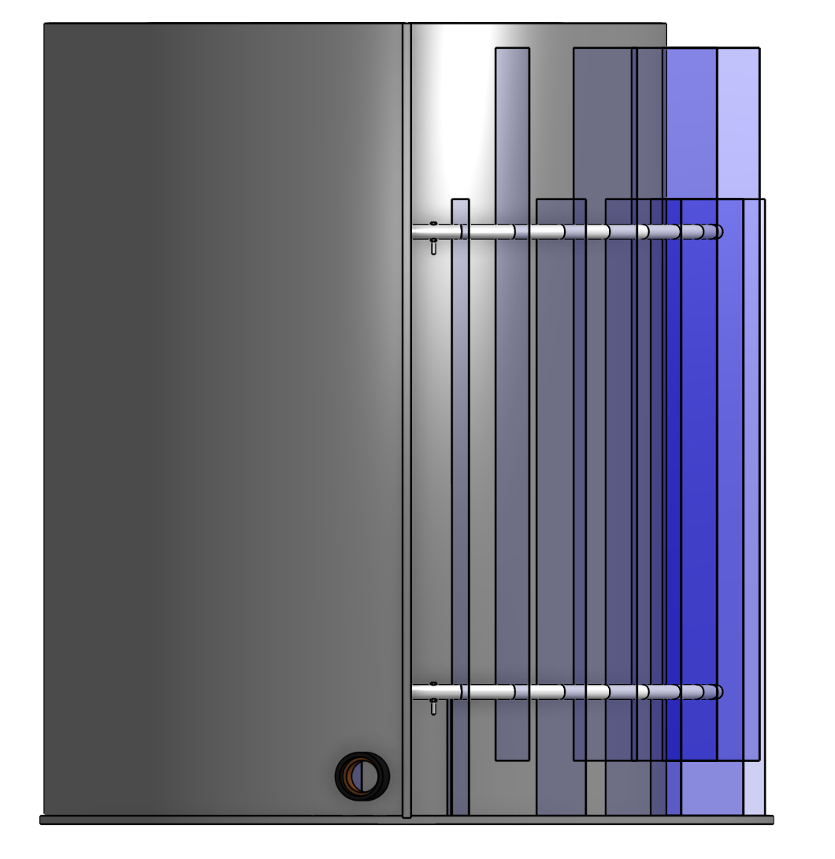
PORT

Slide 3
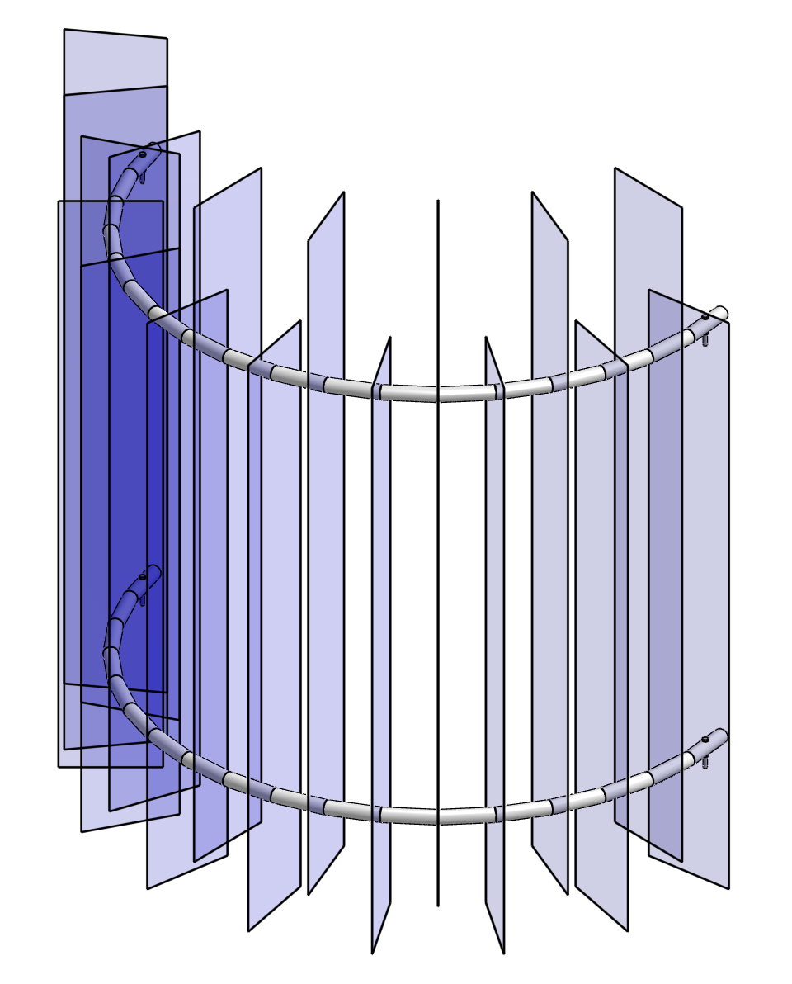

Slide 4
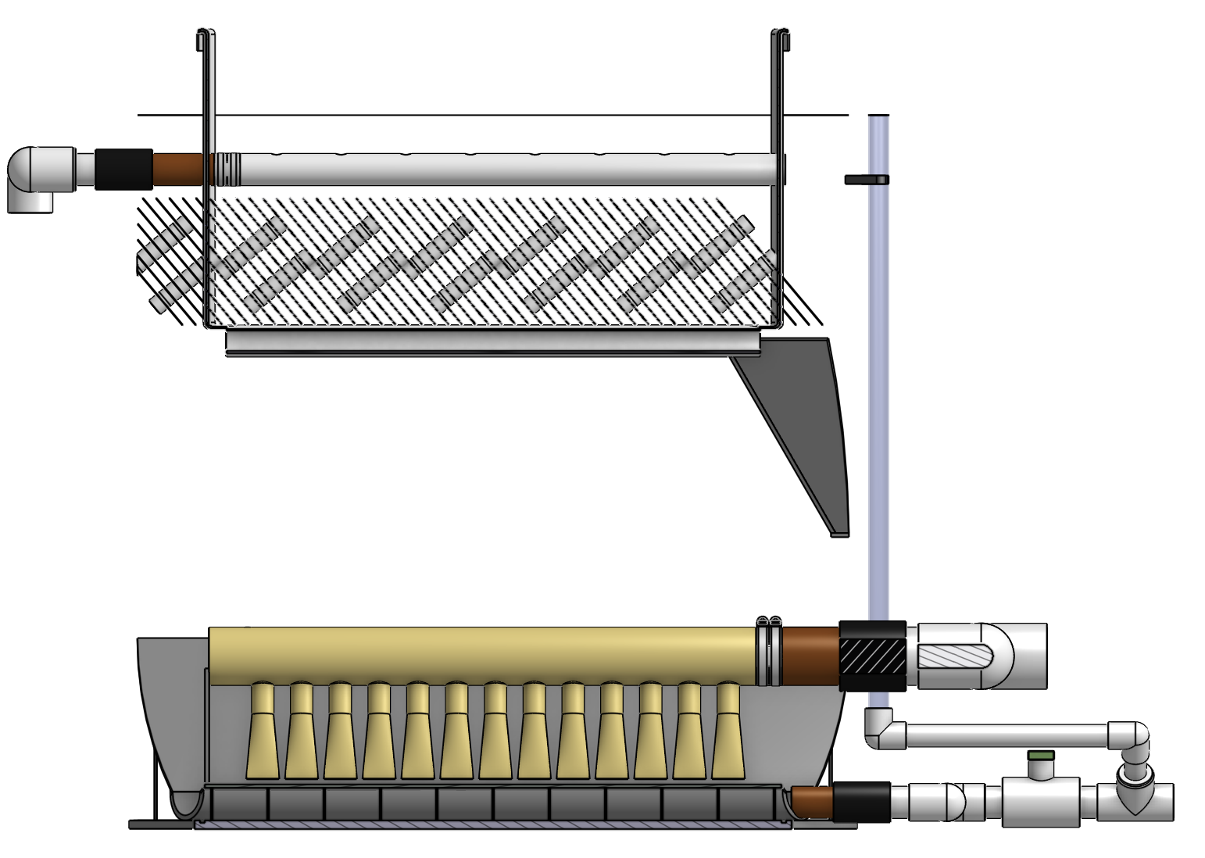
OUTLET MANIFOLD
PLATE SETTLERS
FLOC HOPPER
FLOC FILTER
INLET MANIFOLD

Slide 5
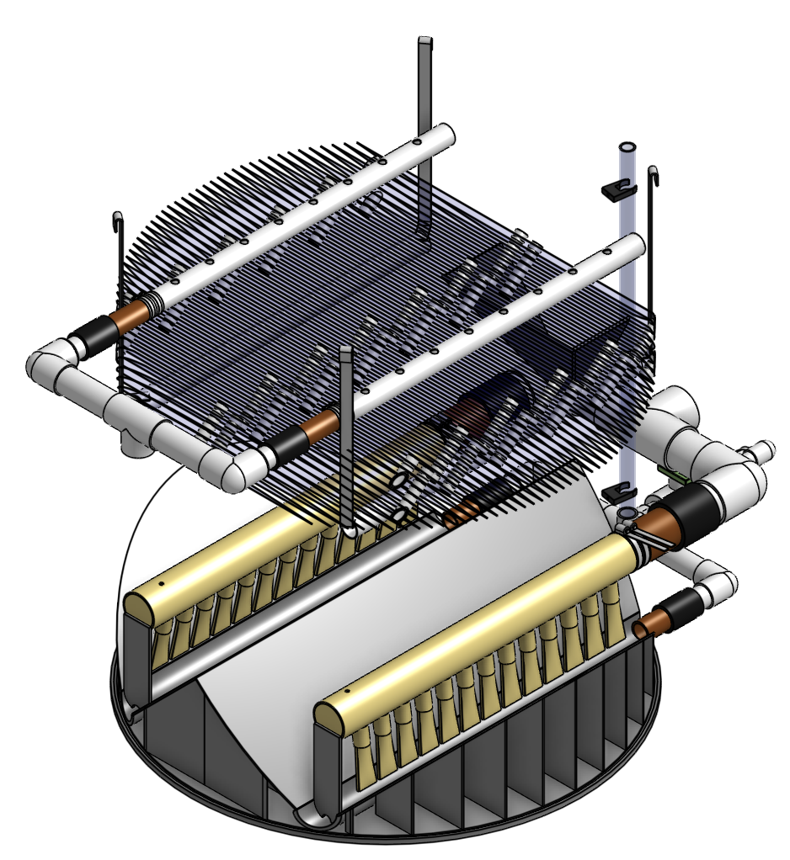

Slide 6
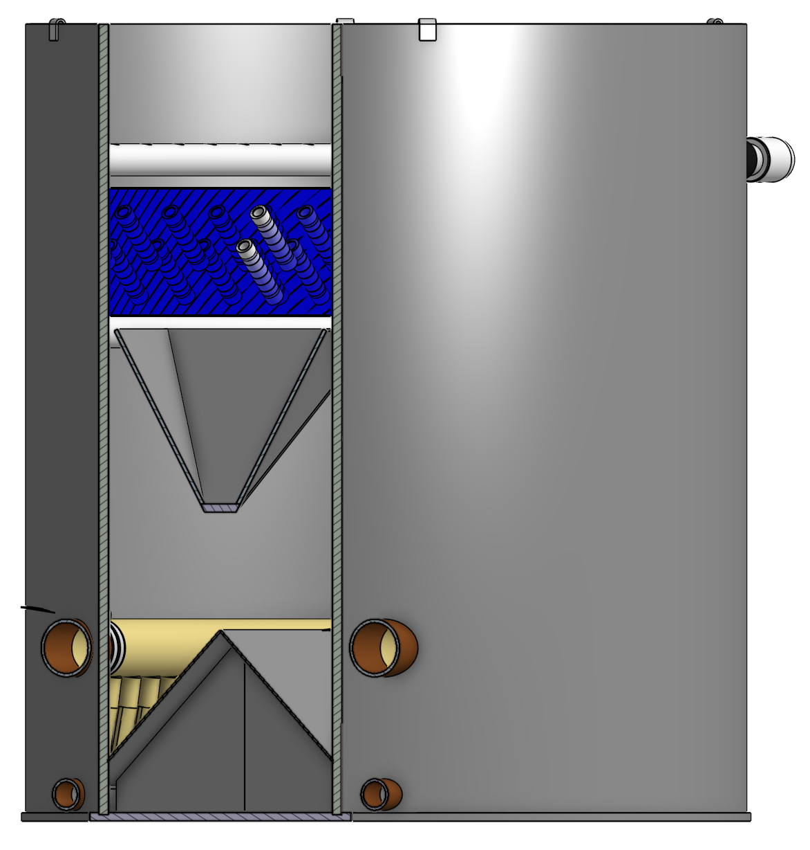
FLOC WEIR
FLOC HOPPPER

Slide 7
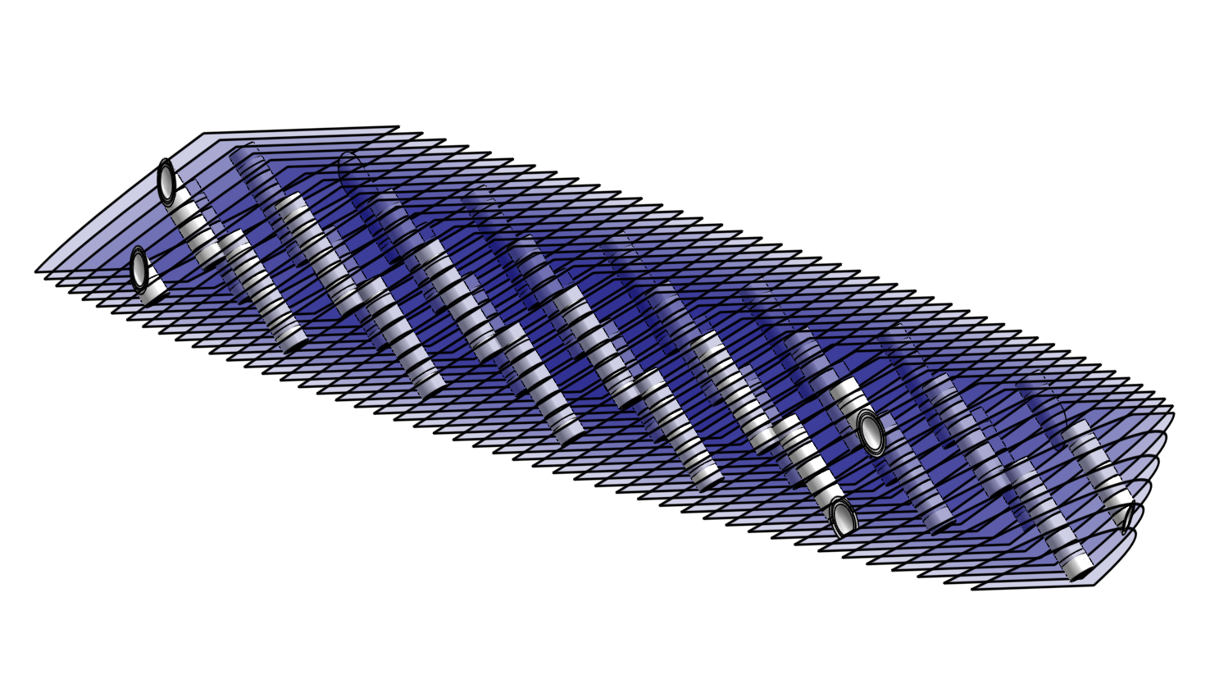

Slide 8
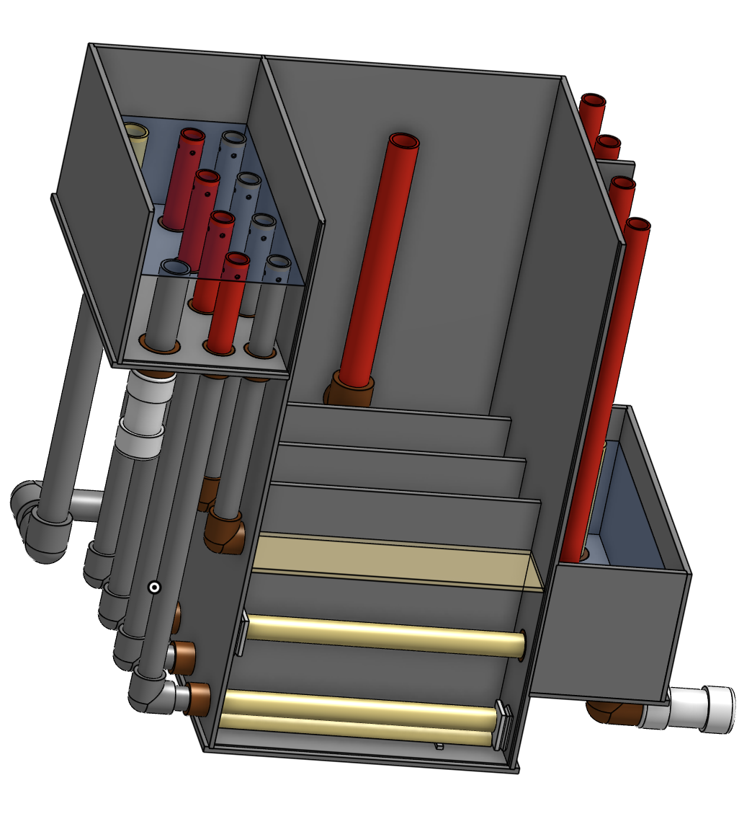
REMOVE PIPE STUBS TO ENABLE BACKWASH IN EACH COMPARTMENT
INLET PIPE
OUTLET PIPE

Slide 9
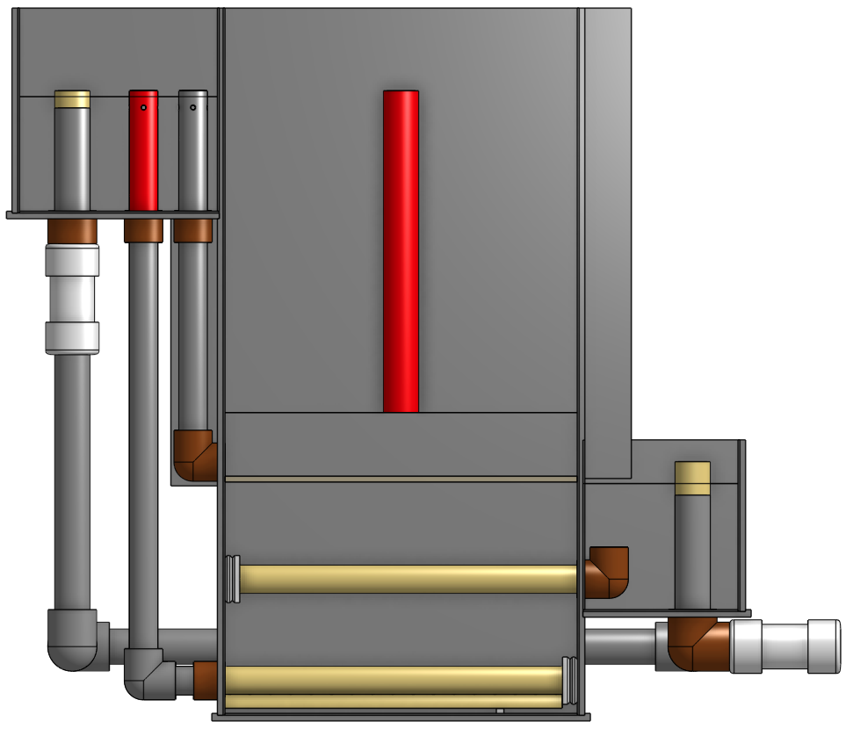
FILTER WATER LEVEL

Slide 10
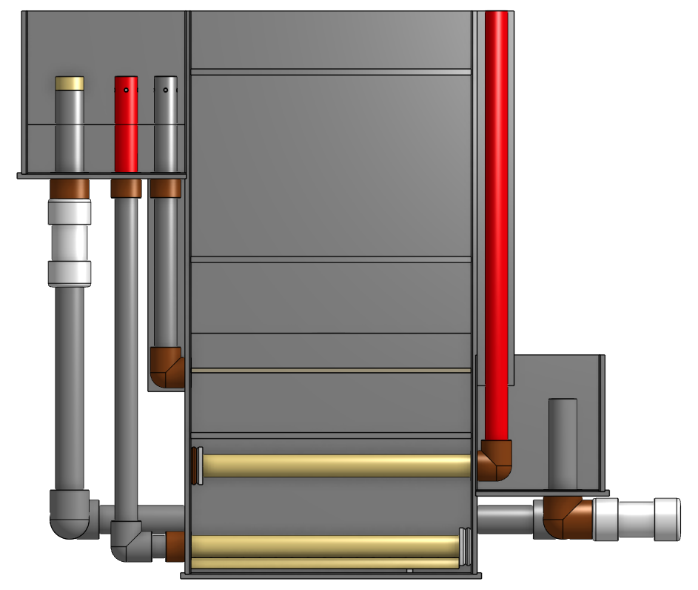
BACKWASH WATER LEVEL
BACKWASH WATER DRAIN
ONE PIPE STUB REMOVED AT A TIME TO BACKWASH EACH COMPARTMENT

Slide 11
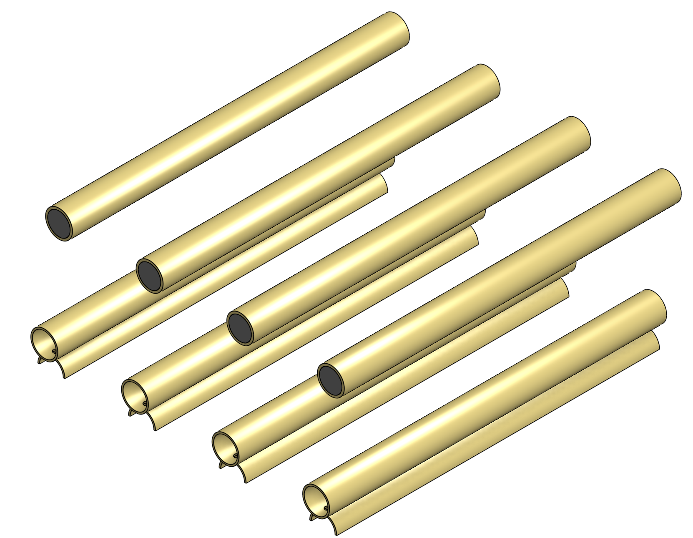
OUTLET BRANCH
INLET BRANCH

Slide 12
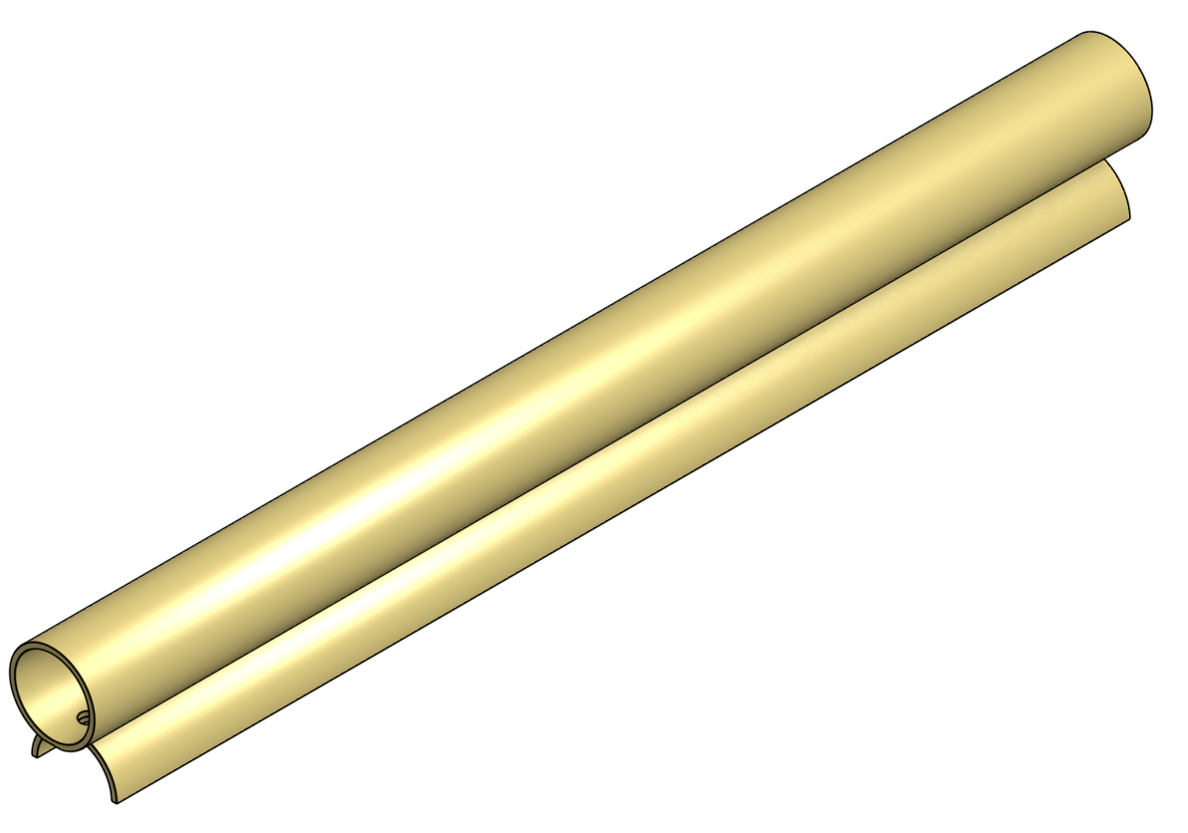
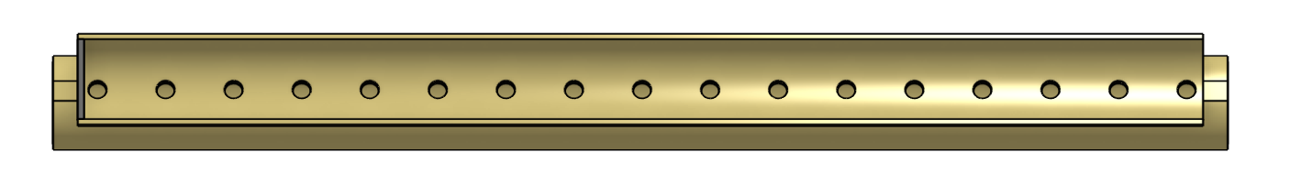
WING
VIEW FROM BELOW

Slide 13


